Slide 1
Programming with B4X
Lesson 3 – My First Program
Anywhere Software
Feb 2021

Slide 2
Today you will learn
How to start B4J
How to create and save a new project
How to run a project
What is error screen.
How to see Turtle commands
How to write a new project using Turtle

Slide 3

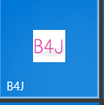
How to start B4J
Probably your teacher has installed B4J to your lab pc so
Let's begin

Slide 4
Create and Save
Notes:
From menu File Select New and then B4XTurtle

Slide 5
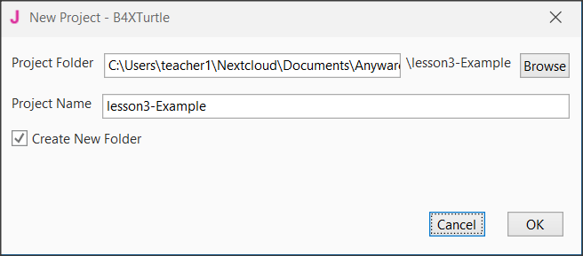
Give a name to your project
Notes:
Explain to students the importance of the right names in each project they create and the value of correct storage in folders in a structured way

Slide 6
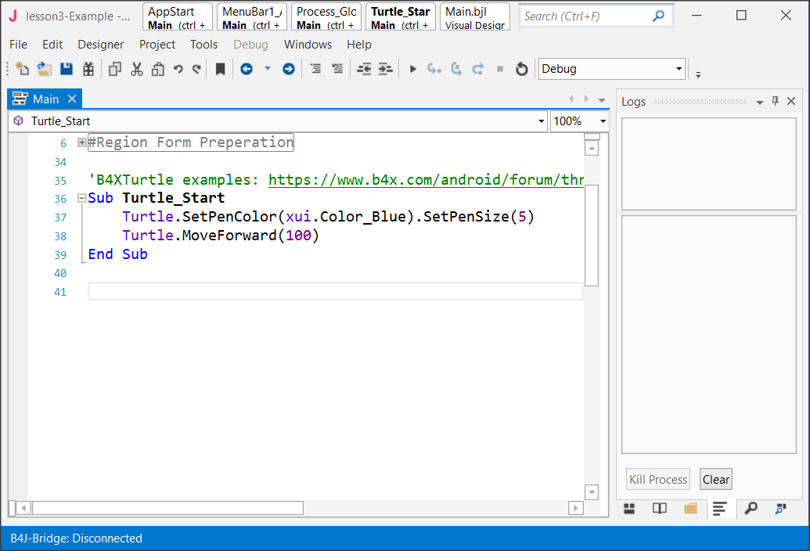
Congratulations!!!

Slide 7

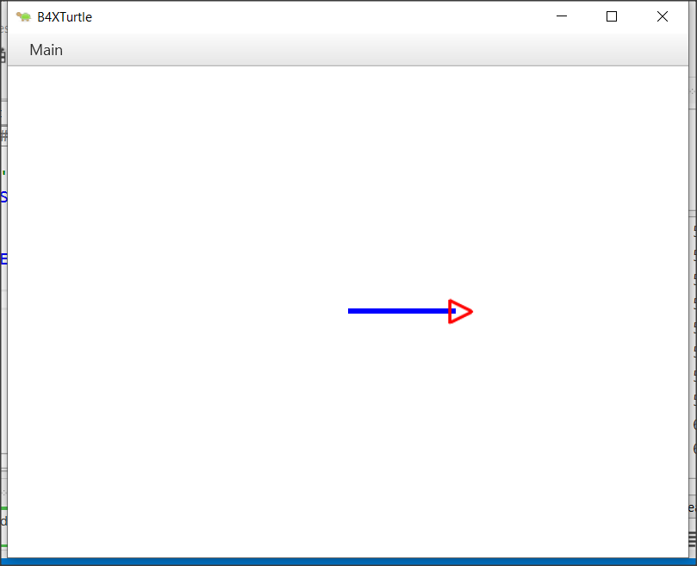
Running the Project
The result
From menu Project select Compile and Run

Slide 8
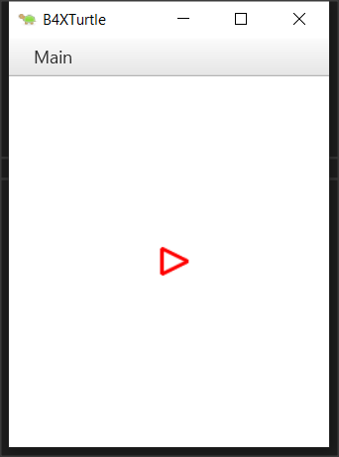
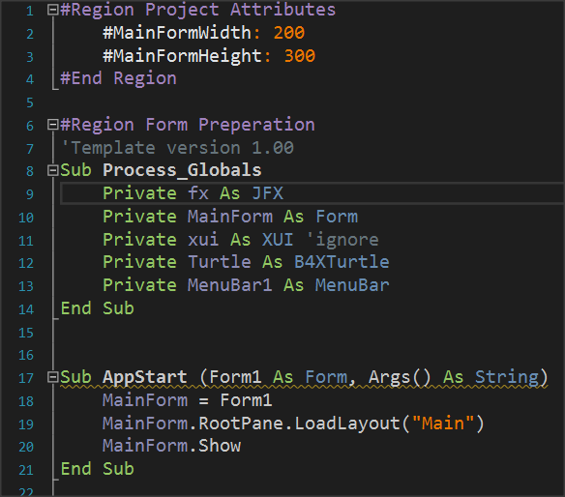
What means Compile?
Compile is a process
Compile
Notes:
Compile is a process
When you need to run a program, the computer should convert what you wrote into a language understood for it. That is, the only language he knows, the machine language or else a series of our known 0 and 1.
Compile is an internal process where the computer makes this conversion. Fortunately we don't have to do anything but press the Compile and Run button or the F5 key. The manufacturer of the language runs the program compiler and ready!
Other useful things are also being done in the Compile process. For example, the code is checked for errors. These errors are also called syntactic errors and can be corrected by the programmer. Later we will see that there are errors that are more difficult to correct or detect but this is another lesson.

Slide 9
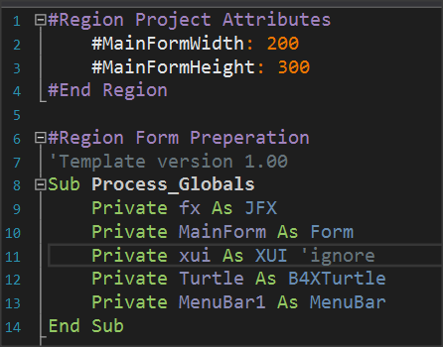
Changing window size
Notes:
You can change application’s window width and height by setting the amount of pixel.
Try it and see what you have done…
If you don’t see #MainFormWidth and #MainFormHeight just click the plus sign left of Region Project Attributes.

Slide 10
Separating Code
In programming we use subs to separate code in small parts.
WHY?
It is easier to create small codes
It is easier to understand small codes
It is easier to find errors
It is cool!
It is cool! (I know I told you that)
Notes:
Every sub has its name, and you can use it by calling its name and passing some data which we call parameters.
Of course, there are more about subs. Remember keep it simple!

Slide 11

Turtle methods
Our turtle is smart. It knows how to do things.
So, it can walk or turn left or right, or draw things
All the things I can do, you can call them Methods

Slide 12
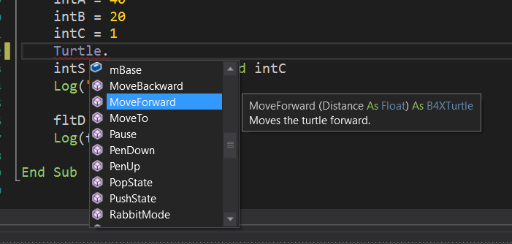
Turtle methods
cool word
In OOP (Object Oriented Programming) every turtle is an Object
Every Object has methods
You can Access Methods by writing
Object’s name and a dot (.)

Slide 13
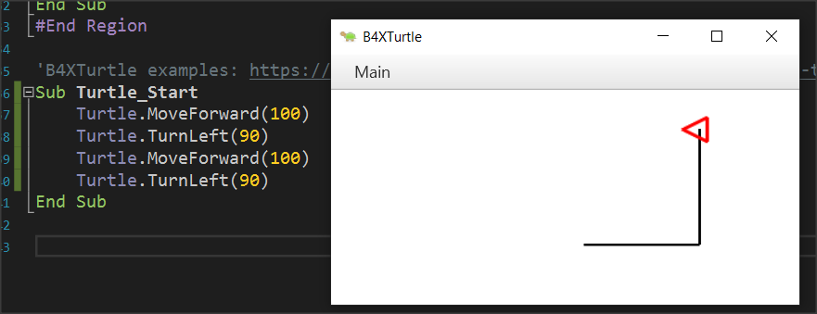
Turtle methods
Can you explain what happens here?
Notes:
Now give some time to pupils to think…

Slide 14

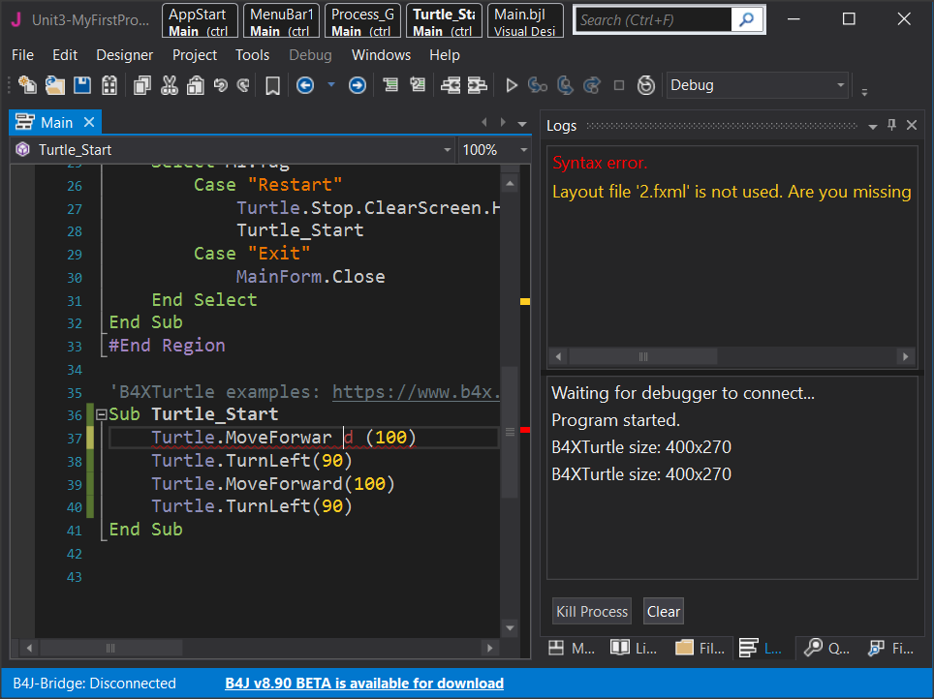
Mistakes? I don’t make mistakes.
Notes:
Usually, mistakes happens when you write something the B4X don’t recognize as command or a process. This errors is easy to find and B4X shows them into log screen. We call them syntax errors.
On the other hand, in computer programming, a logic error is a bug in a program that causes it to operate incorrectly, but not to terminate abnormally (or crash). A logic error produces unintended or undesired output or other behaviour, although it may not immediately be recognized as such.

Slide 15
Thank you!!!
Photos taken From:
https://unsplash.com/photos/iGLLtLINSkw
https://unsplash.com/photos/uq2E2V4LhCY
https://unsplash.com/photos/gySMaocSdqs

